Slide 1
Arrays

Slide 2
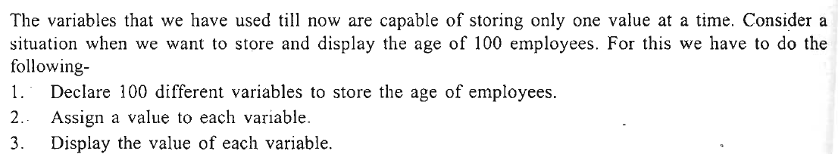
Arrays
An array is a collection of similar type of data items and each data item is called an element of the array.
The data type of the elements may be any valid data type like char, int or float.
The elements of array share the same variable name but each element has a different index number known as subscript.

Slide 3
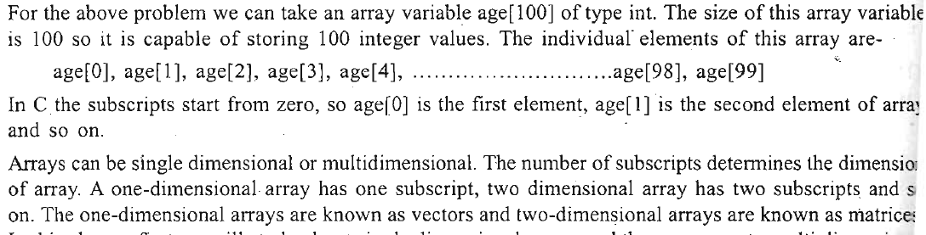

Slide 4
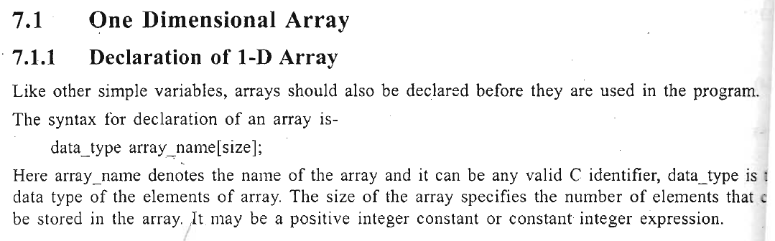
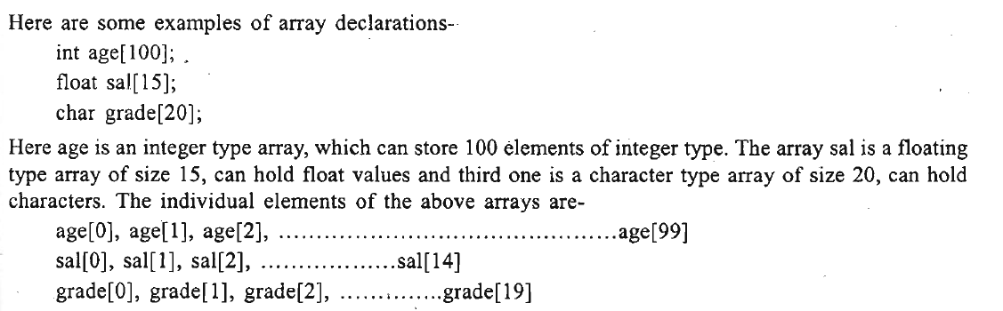

Slide 5
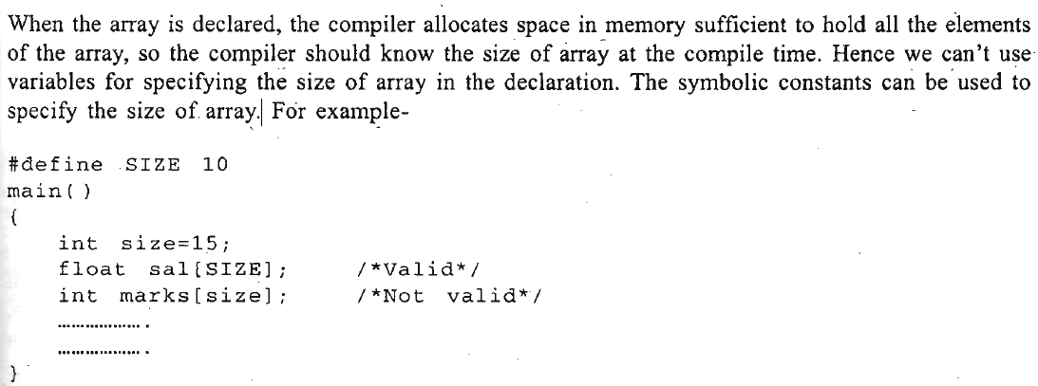

Slide 6
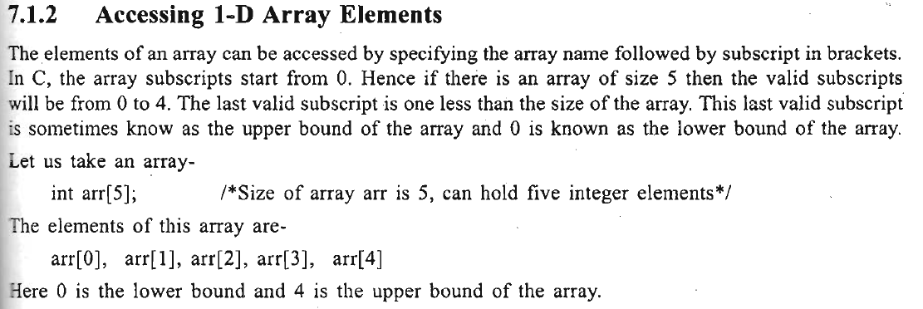
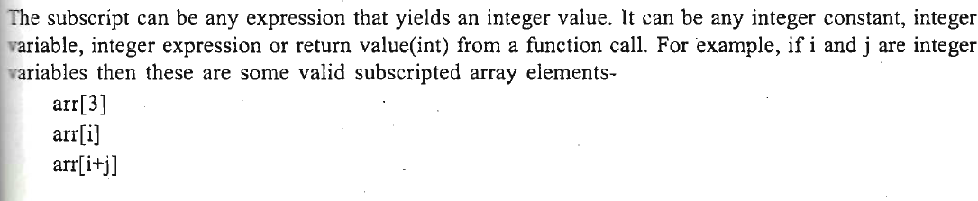


Slide 7
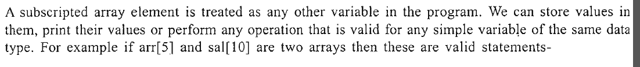
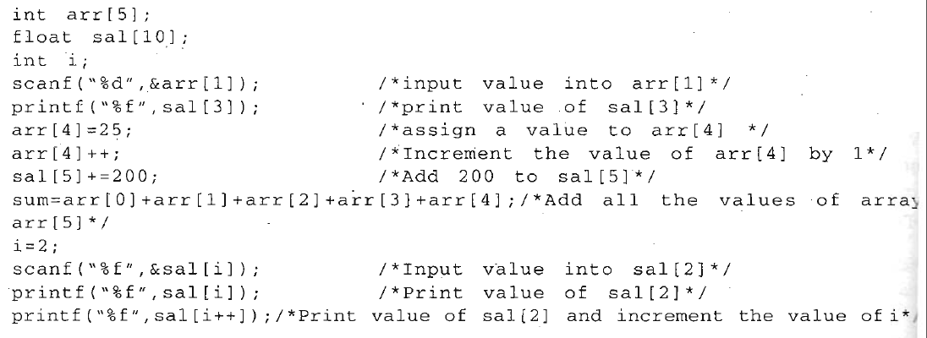
In C there is no check on bounds of the array. For example if we have an array arr[5] , the valid subscripts are only 0, 1, 2, 3, 4 and if someone tries to access elements beyond these subscript like arr[5] , arr[10] or arr[-I], the compiler will not show any error message but this may lead to run time errors, which can be very difficult to debug. So it is the responsibility of programmer to provide array bounds checking wherever needed.

Slide 8
Processing 1-D Arrays
For processing arrays we generally use a for loop and the loop variable is used at the place of subscript
The initial value of loop variable is taken 0 since array subscripts start from zero.
The loop variable is increased by 1 each time so that we can access and process the next element in the array.
The total number of passes in the loop will be equal to the number of elements in the array and in each pass we will process one element.

Slide 9
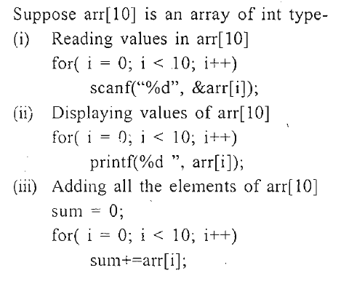

Slide 10
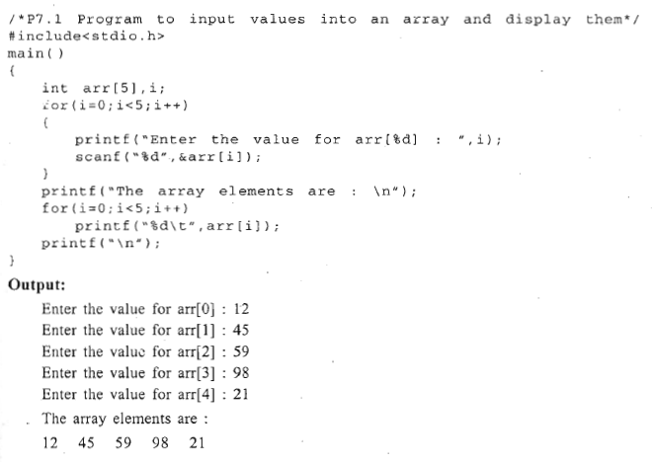

Slide 11
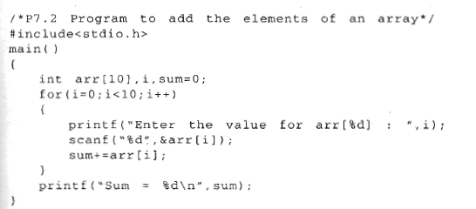

Slide 12
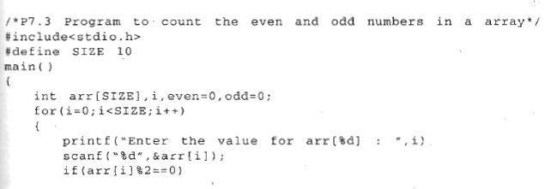
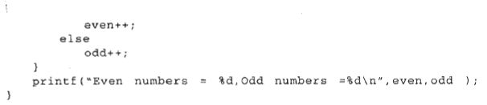

Slide 13
Initialization of I-D Array
After declaration, the elements of a local array have garbage value while the elements of global and static arrays are automatically initialized to zero.
We can explicitly initialize arrays at the time of declaration.
The syntax for initialization of an array is
data_type array_name[size]={value1, value2 ………………value N };

Slide 14
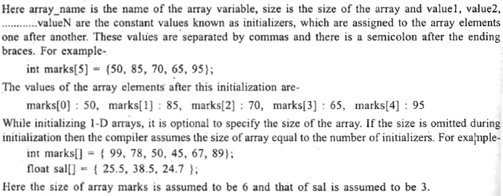
data_type array_name[size]={value1, value2 ………………value N };

Slide 15
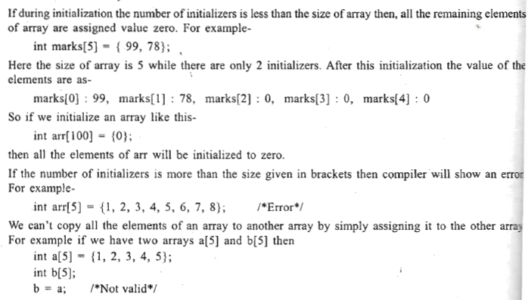


Slide 16
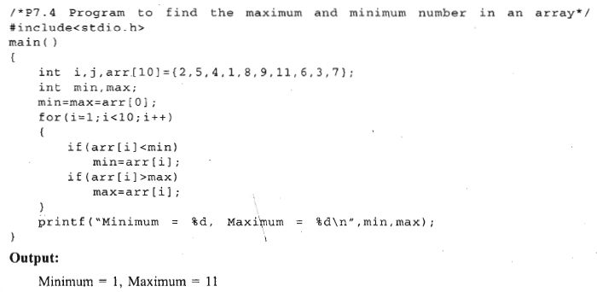

Slide 17
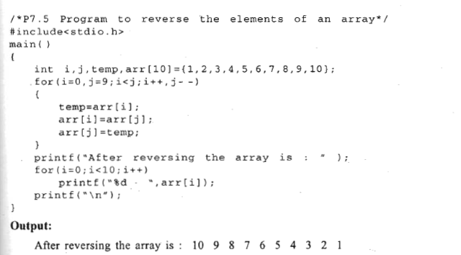
A[0]= r[9]
A[1]=r[8]
A[9]=r[0]
Inside the loop, a[i] is exchanged with a(j] So a[0] will be exchanged with a[9], a[l] with a[8], a[2] with a[7] and so on.

Slide 18
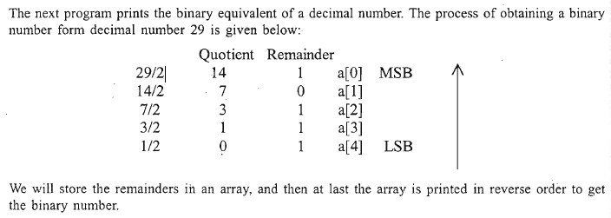

Slide 19
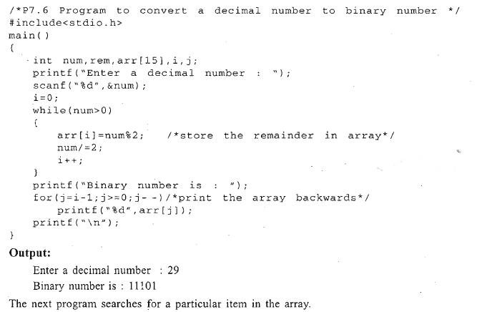

Slide 20
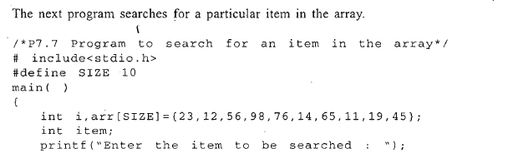
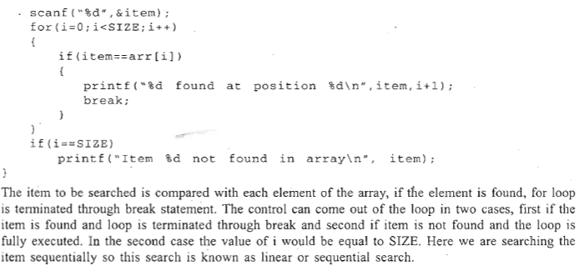

Slide 21
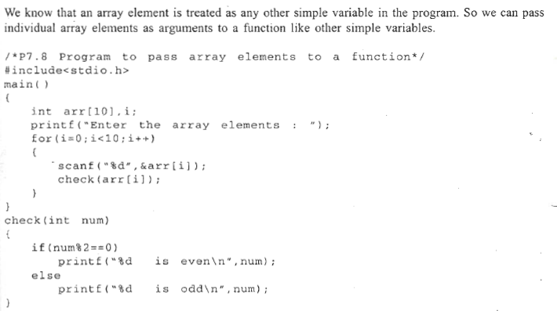
I-D Arrays And Functions
Passing Individual Array Elements to a Function

Slide 22
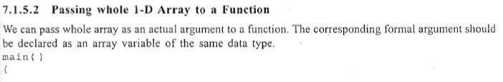
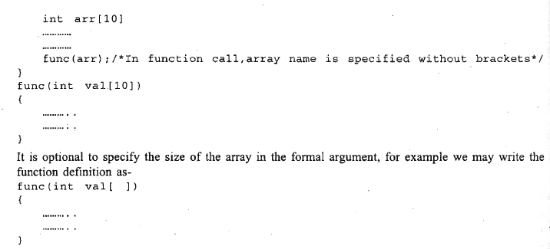

Slide 23
We have studied that changes made in formal arguments do not affect the actual arguments, but this is not the case while passing an array to a function.
The mechanism of passing an array, to a function is quite different from that of passing .a simple variable.
We have studied earlier that in the case of simple variables, the called function creates a copy of the variable and works on it, so any changes, made in the function do not affect the original variable.
When an array is passed as an actual argument, the called function actually gets access to the original array and works on it, so any changes made inside the function affect the original array.

Slide 24
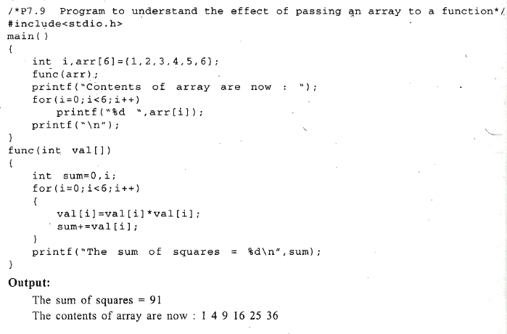

Slide 25
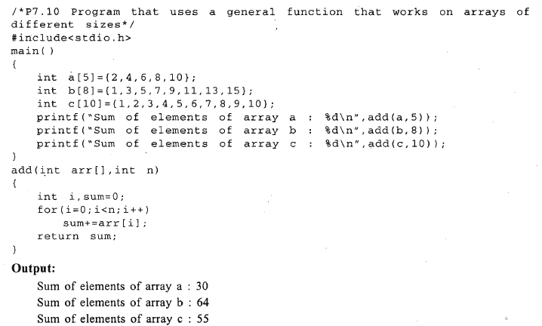

Slide 26
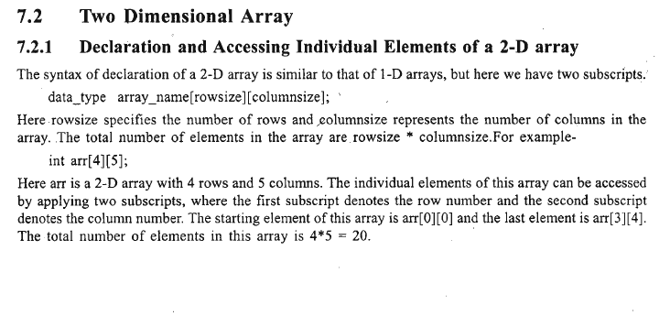
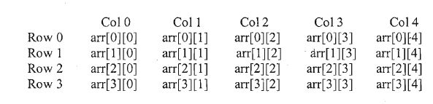

Slide 27
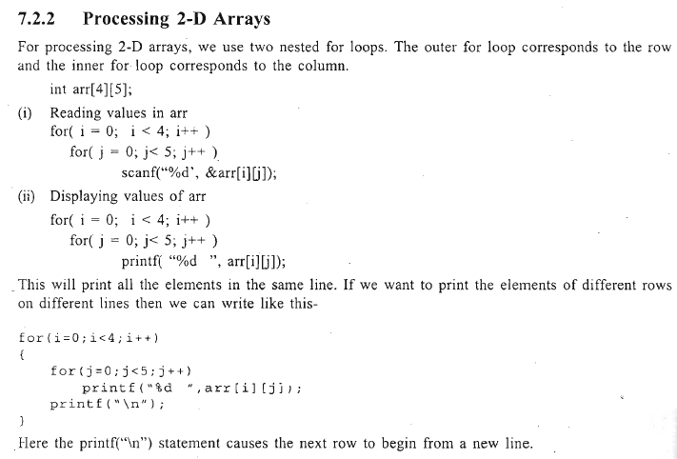
Arr[0][0] arr[0][1] arr[0][4]
Arr [1][0]

Slide 28
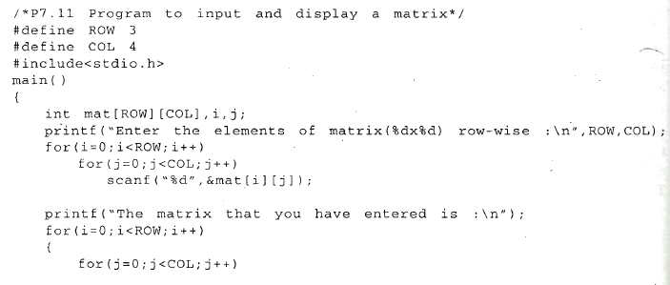
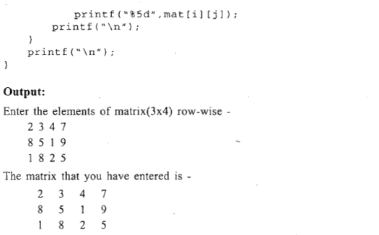

Slide 29
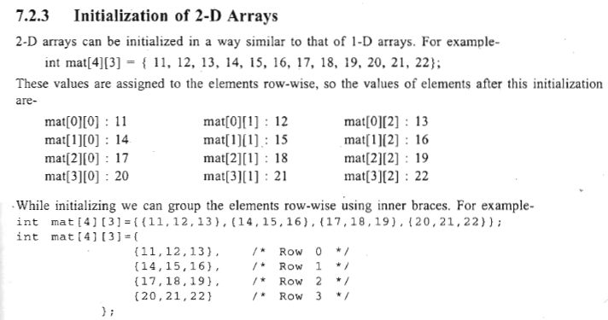

Slide 30
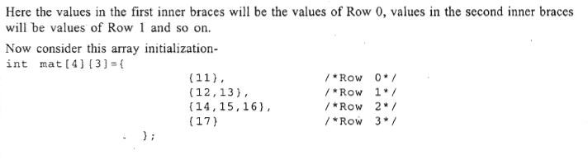

Slide 31
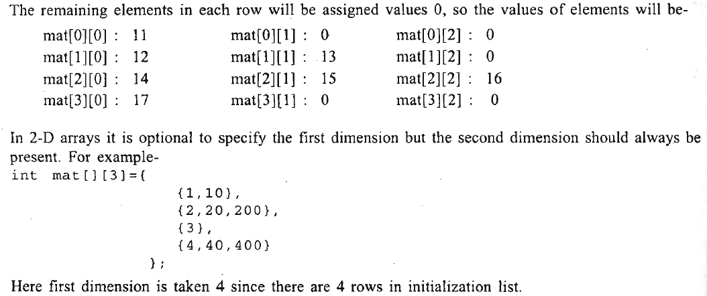

Slide 32
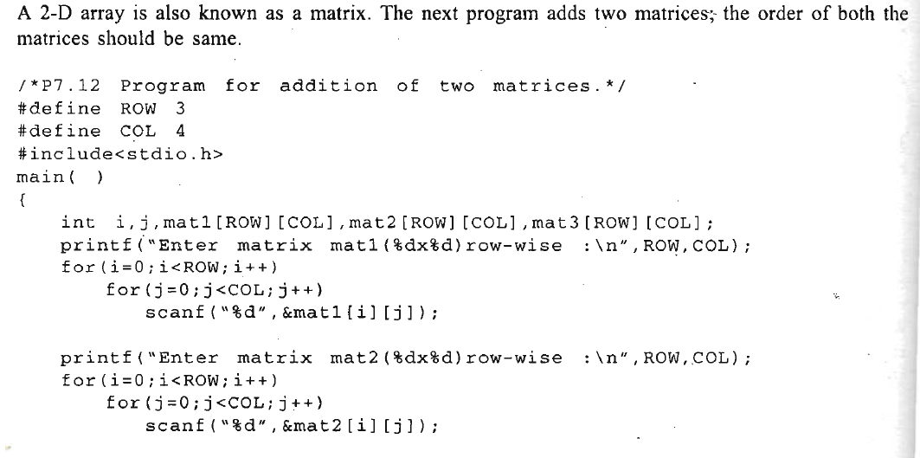

Slide 33
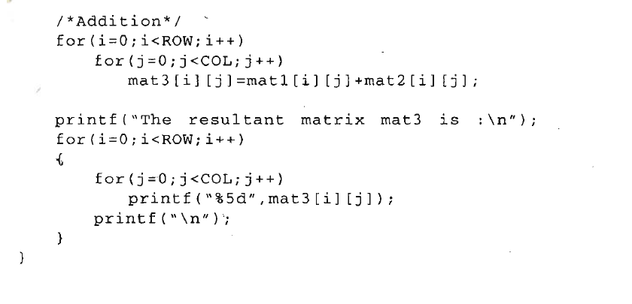

Slide 34
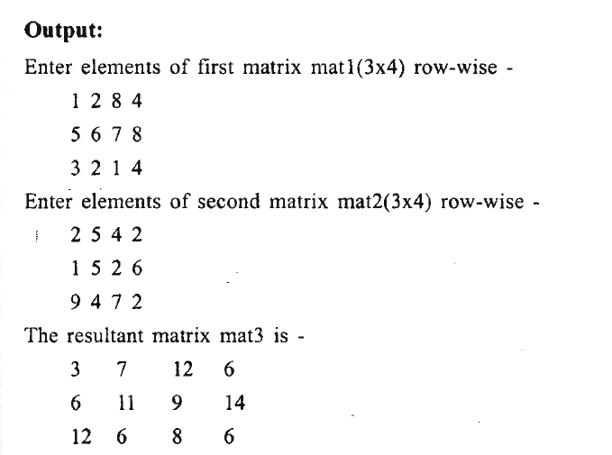

Slide 35
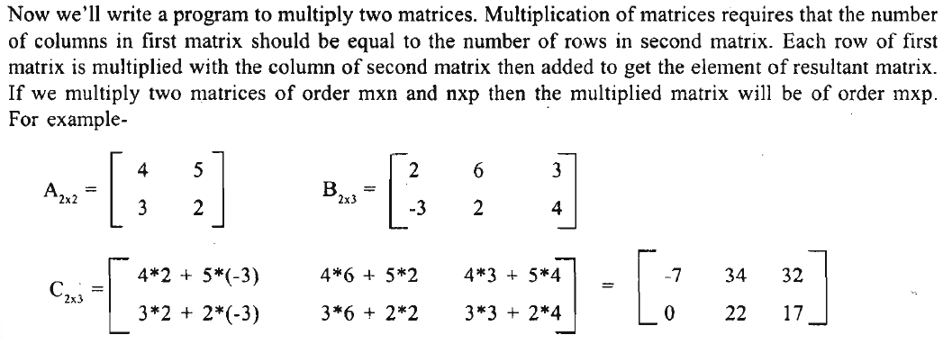

Slide 36
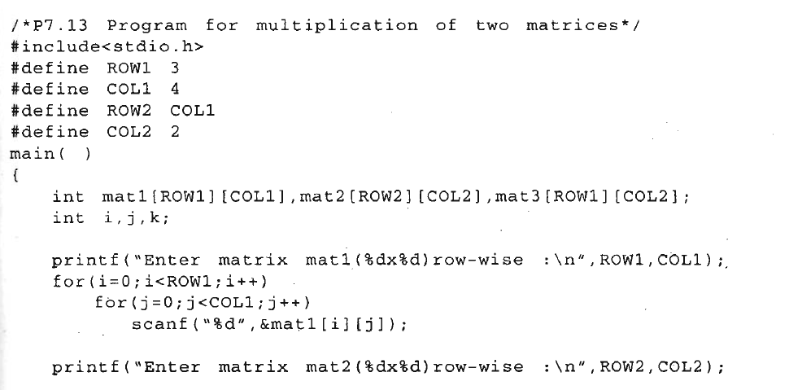

Slide 37
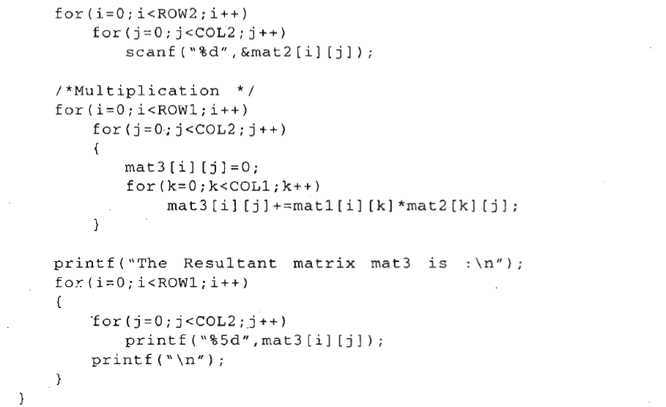

Slide 38
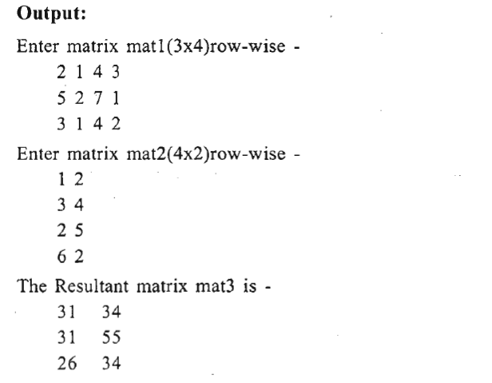

Slide 39
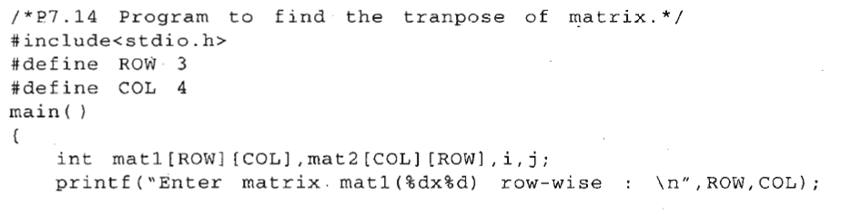
Transpose matrix is defined as the matrix that is obtained by interchanging the rows and columns of a matrix. If a matrix is of mxn order then its transpose matrix will be of order nxm.

Slide 40
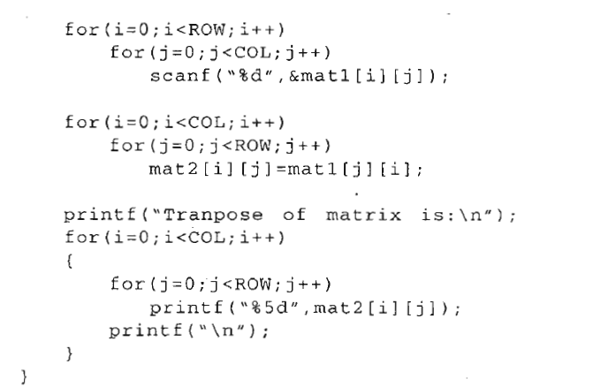
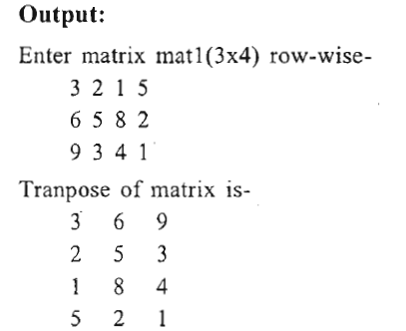

Slide 41
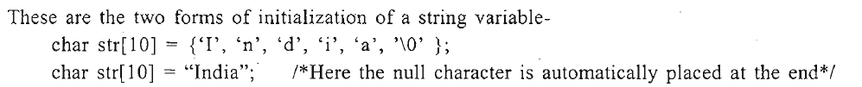
Introduction To Strings
In C, strings are treated as arrays of type char and are terminated by a null character('\O'). This null character has ASCII value zero

Slide 42
